Slide 1

WEEK 02
IT GOVERNANCE
FRAMEWORK
ICT407: IT Governance

Slide 2

Topic & Learning Outcomes (1)
IT Governance Frameworks
01
Understand various frameworks related to IT Governance and Security, such as COBIT, ITIL, CSO, ISO/IEC and NIST.

Slide 3
IT Governance and Security
Goal: Understanding the key concepts related to IT Governance and Security.

Slide 4
Open-Ended Question
How do IT governance frameworks support organizations in aligning IT strategies with business objectives and improving overall performance?
IT governance frameworks are essential tools that help organizations ensure their IT strategies align with their business objectives. These frameworks, such as COBIT, ITIL, and ISO standards, provide structured approaches to managing IT resources, mitigating risks, ensuring compliance with regulations, and optimizing the value of IT investments. For example, a financial institution in Sydney might implement COBIT to align its IT operations with strategic goals, ensuring regulatory compliance and enhancing operational efficiency. By leveraging these frameworks, organizations can achieve better decision-making, improved accountability, and ultimately enhanced performance.

Slide 5
Information Technology (IT) has evolved from being a mere support tool to a critical part of business strategy, influencing operations, internal audits, compliance, and decision-making processes. In response to major frauds like Enron and WorldCom, companies have developed corporate governance structures to clearly define and oversee the roles and responsibilities of shareholders, management, and employees.
Introduction
IT is no longer a supporting tool for business, but a fundamental component of company strategy in roles such as operations, internal audit, compliance and decision support.
The wake of large-scale frauds, such as Enron and WorldCom
Companies and organisations started to device corporate governance structures to clarify and monitor the respective roles and responsibilities of shareholders, management and employees.

Slide 6
In Sydney, a large financial institution integrated IT into its core strategy by implementing advanced data analytics for real-time monitoring and compliance. This helped the institution improve its decision-making and ensure adherence to regulatory standards, thereby enhancing transparency and trust among shareholders and employees.
Introduction
IT is no longer a supporting tool for business, but a fundamental component of company strategy in roles such as operations, internal audit, compliance and decision support.
The wake of large-scale frauds, such as Enron and WorldCom
Companies and organisations started to device corporate governance structures to clarify and monitor the respective roles and responsibilities of shareholders, management and employees.

Slide 7
Open-Ended Question
How do IT governance frameworks enhance information security within an organization?
IT governance frameworks like ISO 27001 provide guidelines and standards for managing information security. They help organizations identify security risks, implement appropriate controls, and ensure continuous monitoring and improvement of security measures.

Slide 8
Example
A tech company in Melbourne implements ISO 27001 to enhance its information security, ensuring the protection of sensitive customer data and compliance with legal standards.

Slide 9
Open-Ended Question
What are the primary benefits of implementing IT governance frameworks in organizations?
Implementing IT governance frameworks provides several benefits, including improved alignment between IT and business goals, enhanced risk management, better regulatory compliance, and increased accountability. These frameworks ensure that IT investments effectively support the organization's strategic objectives. For example, a financial institution in Sydney uses the COBIT framework to align its IT operations with business goals, ensuring regulatory compliance and enhancing operational efficiency.

Slide 10
IT Governance and Security
IT Governance consists of structures, processes and operational mechanisms that work together to ensure that IT investments and business objectives are aligned.
IT Governance aims to provide decision-makers an acceptable level of assurance that an organisation strategic objectives are not jeopardized by IT failures.
IT Governance framework, such as CobiT, ITIL, VaIIT and ISO 38500
However, there is no absolute standard IT governance, combination works best depending on business factors, corporate culture, IT maturity and staffing capacity
IT Governance and Security involve establishing structures, processes, and mechanisms that ensure IT investments are aligned with business objectives, providing decision-makers with confidence that strategic goals will not be compromised by IT failures. Various frameworks, such as CobiT, ITIL, ValIT, and ISO 38500, can be used, but the best approach depends on the organization’s specific needs, culture, and IT maturity.

Slide 11
IT Governance and Security
IT Governance consists of structures, processes and operational mechanisms that work together to ensure that IT investments and business objectives are aligned.
IT Governance aims to provide decision-makers an acceptable level of assurance that an organisation strategic objectives are not jeopardized by IT failures.
IT Governance framework, such as CobiT, ITIL, VaIIT and ISO 38500
However, there is no absolute standard IT governance, combination works best depending on business factors, corporate culture, IT maturity and staffing capacity
In Canberra, a public sector organization named "Canberra Public Services" adopted the ISO 38500 framework to enhance its IT governance. This helped the organization align its IT strategies with its public service goals, improve operational efficiency, and ensure that IT systems supported the overall strategic objectives without failures.

Slide 12
Open-Ended Question
How can organizations practically apply IT governance frameworks to improve their IT operations?
Organizations can apply IT governance frameworks by defining clear roles and responsibilities, establishing processes for decision-making, and using metrics to monitor performance. This approach helps in managing risks, ensuring regulatory compliance, and improving IT service delivery. For example, a healthcare provider in Brisbane adopts ITIL to improve IT service management, leading to better patient care and operational efficiency.

Slide 13
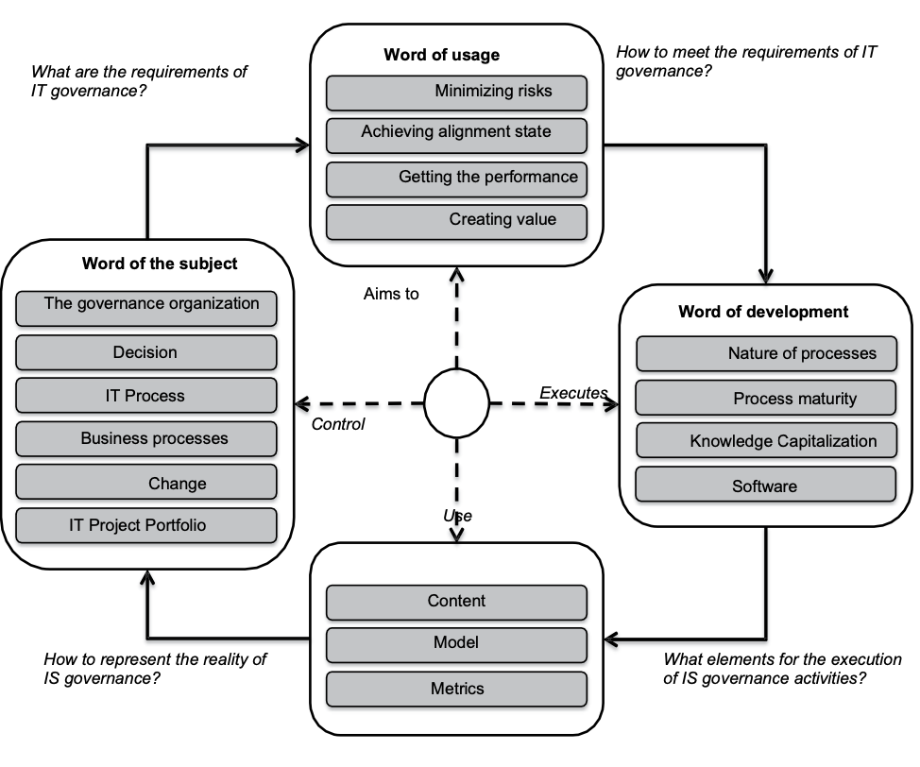
IT Governance Framework
The IT Governance Framework outlines the components and requirements necessary for effective IT governance, focusing on minimizing risks, achieving alignment with business objectives, enhancing performance, and creating value. It involves governance organization, decision-making, IT processes, business processes, and project portfolios, supported by development aspects such as process maturity, knowledge capitalization, and software tools.

Slide 14
IT Governance Framework
In Brisbane, "Brisbane Tech Solutions" implemented an IT Governance Framework using the CobiT model. This framework helped them minimize IT risks and align IT projects with their strategic business goals, ensuring efficient performance and creating value for stakeholders through mature processes and well-defined metrics.

Slide 15
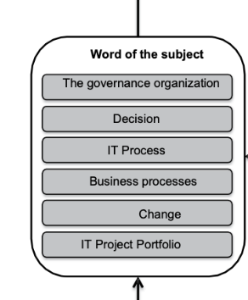
IT Governance Subject
Organisation of Governance: Organisation decision making
Centralised vs. collaborative decision making
Decision: IT Principles, Architecture, Infrastructure, Business Applications.
IT Process: A set of processes that make it possible to control that objectives assigned to the IS are well-considered and to reach if necessary.
Business Process: A structured and measured framework of activities designed to produce a specific output for a customer or market.
Change: management of organisation’s transformation processes and its business or IT processes.
IT Project Portfolio: The object of IT governance.
The IT Governance Subject details the key components of IT governance, including the organization of governance, decision-making processes, IT processes, business processes, change management, and IT project portfolios. These elements collectively ensure that IT governance is effective in aligning IT objectives with business goals.

Slide 16
IT Governance Subject
Organisation of Governance: Organisation decision making
Centralised vs. collaborative decision making
Decision: IT Principles, Architecture, Infrastructure, Business Applications.
IT Process: A set of processes that make it possible to control that objectives assigned to the IS are well-considered and to reach if necessary.
Business Process: A structured and measured framework of activities designed to produce a specific output for a customer or market.
Change: management of organisation’s transformation processes and its business or IT processes.
IT Project Portfolio: The object of IT governance.
In Melbourne, "Melbourne Health Network" implemented a centralized IT governance structure to streamline decision-making processes related to IT principles, architecture, and business applications. This helped the organization effectively manage IT projects and changes, ensuring that IT investments supported their healthcare delivery objectives and improved patient care outcomes.

Slide 17
Open-Ended Question
Can you provide an example in Australia that apply IT governance framework for a better decision-making?
A healthcare provider in Brisbane adopts ITIL to improve IT service management, leading to better patient care and operational efficiency.

Slide 18
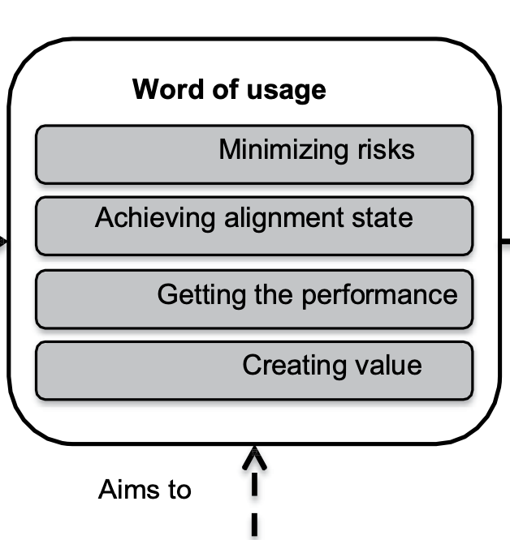
IT Governance Usage
Minimizing Risks: managing projects, business process or ensuring the satisfaction of IT users in terms of security.
Achieving Alignment State: satisfying the need for support from the actors of an organisation.
Getting the Performance: mastering the business and IS processes. Two strategies used: ad hoc strategy and a strategy guided by process of maturity.
Creating Value: capturing the elements of value concerned: IT Assets, Business Assets and IT usage. Two types of values addressed are
Financial value of the human, material
Heritage value of the energy resources used.
The IT Governance Usage highlights key goals of IT governance: minimizing risks, achieving alignment between IT and business objectives, enhancing performance through mature processes, and creating value from IT and business assets. These aims ensure IT supports and drives overall business success.

Slide 19
IT Governance Usage
Minimizing Risks: managing projects, business process or ensuring the satisfaction of IT users in terms of security.
Achieving Alignment State: satisfying the need for support from the actors of an organisation.
Getting the Performance: mastering the business and IS processes. Two strategies used: ad hoc strategy and a strategy guided by process of maturity.
Creating Value: capturing the elements of value concerned: IT Assets, Business Assets and IT usage. Two types of values addressed are
Financial value of the human, material
Heritage value of the energy resources used.
In Brisbane, "Brisbane Utilities Company" implemented an IT governance strategy to minimize risks associated with their IT projects, align IT services with business needs, and optimize performance. By focusing on creating value from their IT assets and ensuring efficient use of resources, the company enhanced operational efficiency and customer satisfaction.

Slide 20
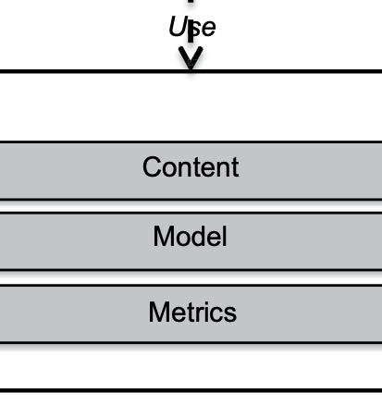
IT Governance System
Content: valuable information for decision making
Document for alignment
Document for management:
Resource management document
Risk management document
Performance management documents
Value management documents
Maturity management documents
Model: representation of a domain and are the support for analysis and reasoning (Process, Objects, Decision, Evolution).
Metric: tool to enable decision-makers to assess the current situation concerning the objectives to be achieved.
We outline the structure and components of an IT Governance System, which is essential for ensuring that IT resources are utilized effectively to meet organizational goals.
Content: This includes all necessary documents that provide valuable information for decision-making. Examples are documents for alignment, resource management, risk management, performance management, value management, and maturity management.
Model: These are representations of a domain that support analysis and reasoning, such as processes, objects, decisions, and their evolution.
Metrics: Tools that enable decision-makers to evaluate the current situation against the set objectives.

Slide 21
IT Governance System
Content: valuable information for decision making
Document for alignment
Document for management:
Resource management document
Risk management document
Performance management documents
Value management documents
Maturity management documents
Model: representation of a domain and are the support for analysis and reasoning (Process, Objects, Decision, Evolution).
Metric: tool to enable decision-makers to assess the current situation concerning the objectives to be achieved.
Imagine a company in Sydney, Australia, named "Tech Innovations Ltd." They implement an IT Governance System to improve their IT resource management. They use:
Content: A risk management document to identify and mitigate IT risks.
Model: A process model to streamline IT service delivery.
Metrics: Key performance indicators (KPIs) to track IT project success rates and ensure they align with business objectives.

Slide 22
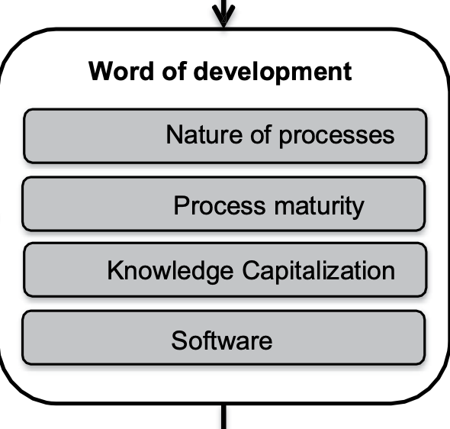
IT Governance Development
Nature of Processes: a set of activities coordinated and executed by a system engineer to produce the governance of IS.
Process Maturity: the maturity level of the development process has a strong impact on the performance of ISG activities.
Capitalisation of Knowledge: socialization, outsourcing, internationalisation and combination values.
Software: IT media dedicated to ISG
We explain the elements involved in IT Governance Development, focusing on processes, maturity, knowledge, and software.
Nature of Processes: Refers to the coordinated activities executed by a system engineer to govern information systems (IS).
Process Maturity: Highlights the importance of the development process maturity level on the performance of IT governance activities.
Capitalisation of Knowledge: Involves activities such as socialization, outsourcing, internationalization, and combination of values.
Software: Denotes the IT tools and applications dedicated to supporting IT governance.

Slide 23
IT Governance Development
Nature of Processes: a set of activities coordinated and executed by a system engineer to produce the governance of IS.
Process Maturity: the maturity level of the development process has a strong impact on the performance of ISG activities.
Capitalisation of Knowledge: socialization, outsourcing, internationalisation and combination values.
Software: IT media dedicated to ISG
Consider a company in Melbourne, Australia, called "Digital Horizons Ltd." They are developing their IT governance system:
Nature of Processes: Implementing a series of activities for IT service management.
Process Maturity: Assessing their IT processes' maturity to improve governance efficiency.
Capitalisation of Knowledge: Leveraging outsourcing to international partners for knowledge sharing.
Software: Utilizing specialized IT governance software to manage and monitor their IT resources effectively.

Slide 24
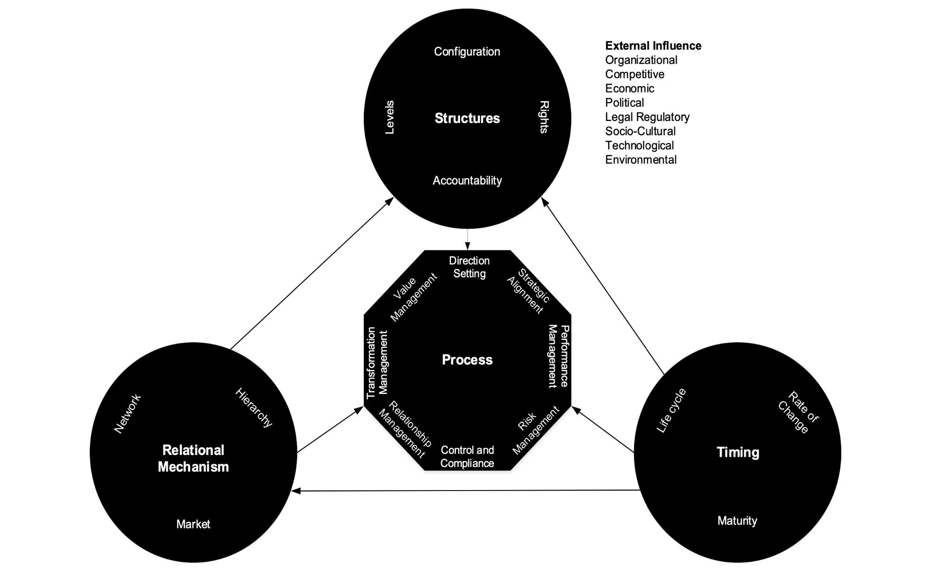
IT Governance Model
We show the IT Governance Model, which focuses on three core components: Structures, Processes, and Relational Mechanisms, influenced by external factors like organizational, competitive, and technological elements. These components interact to ensure effective IT governance within an organization.

Slide 25
IT Governance Model
Consider a company in Canberra, Australia, named "Innovate Tech Pty Ltd." They implement this IT Governance Model by:
Structures: Establishing clear levels of accountability and rights for IT management.
Processes: Implementing strategic alignment and performance management practices to guide IT operations.
Relational Mechanisms: Utilizing networks and hierarchies to facilitate relationship management and transformation management.

Slide 26
Focus of IT Governance
IT Governance focus area is divided into five subareas:
Strategic Alignment
Value Delivery
Resource Management
Risk Management
Performance Management
We outline the five key subareas that IT Governance focuses on: Strategic Alignment, Value Delivery, Resource Management, Risk Management, and Performance Management. These areas ensure that IT investments align with business goals, deliver value, manage resources effectively, mitigate risks, and monitor performance.

Slide 27
Focus of IT Governance
Consider a company in Brisbane, Australia, called "FutureTech Solutions." They focus on:
Strategic Alignment: Ensuring IT strategies align with business objectives.
Value Delivery: Maximizing the value from IT investments.
Resource Management: Efficiently managing IT resources and capabilities.
Risk Management: Identifying and mitigating IT-related risks.
Performance Management: Monitoring and evaluating IT performance to achieve desired outcomes.
IT Governance focus area is divided into five subareas:
Strategic Alignment
Value Delivery
Resource Management
Risk Management
Performance Management

Slide 28
IT Governance Frameworks
Goal: Understanding various frameworks related to IT Governance and Security.

Slide 29
Open-Ended Question
What are the main components of the COBIT framework and how do they support IT governance?
The COBIT framework consists of components like processes, organizational structures, and information flows. These elements help organizations develop, implement, and improve IT governance practices, ensuring that IT aligns with business goals and manages risks effectively.

Slide 30
Example
A government agency in Canberra uses COBIT to structure its IT governance, ensuring that IT investments align with public service goals and regulatory requirements.

Slide 31

COBIT
COBIT (Control Objectives for Information and Related Technology) helps organisations meet business challenges in regulatory compliance, risk management and aligning IT strategy with organisational goals.
The COBIT framework is considered to be a generic, comprehensive, independent, and large body of knowledge designed to measure the maturity of IT processes within organizations of all sizes, whether commercial, not-for-profit, or in the public sector.
We introduce COBIT (Control Objectives for Information and Related Technology), a framework that aids organizations in managing regulatory compliance, risk management, and aligning IT strategy with organizational goals. It is described as a comprehensive, independent body of knowledge that measures the maturity of IT processes across various types of organizations.

Slide 32
COBIT
COBIT (Control Objectives for Information and Related Technology) helps organisations meet business challenges in regulatory compliance, risk management and aligning IT strategy with organisational goals.
The COBIT framework is considered to be a generic, comprehensive, independent, and large body of knowledge designed to measure the maturity of IT processes within organizations of all sizes, whether commercial, not-for-profit, or in the public sector.
Consider a company in Sydney, Australia, called "SynergyTech Solutions." They adopt the COBIT framework to:
Ensure their IT operations comply with regulatory standards.
Mitigate risks associated with IT projects.
Align their IT strategy with business objectives to improve efficiency and performance.
By using COBIT, SynergyTech can systematically evaluate and improve their IT processes, ensuring they meet both business and compliance requirements effectively.

Slide 33
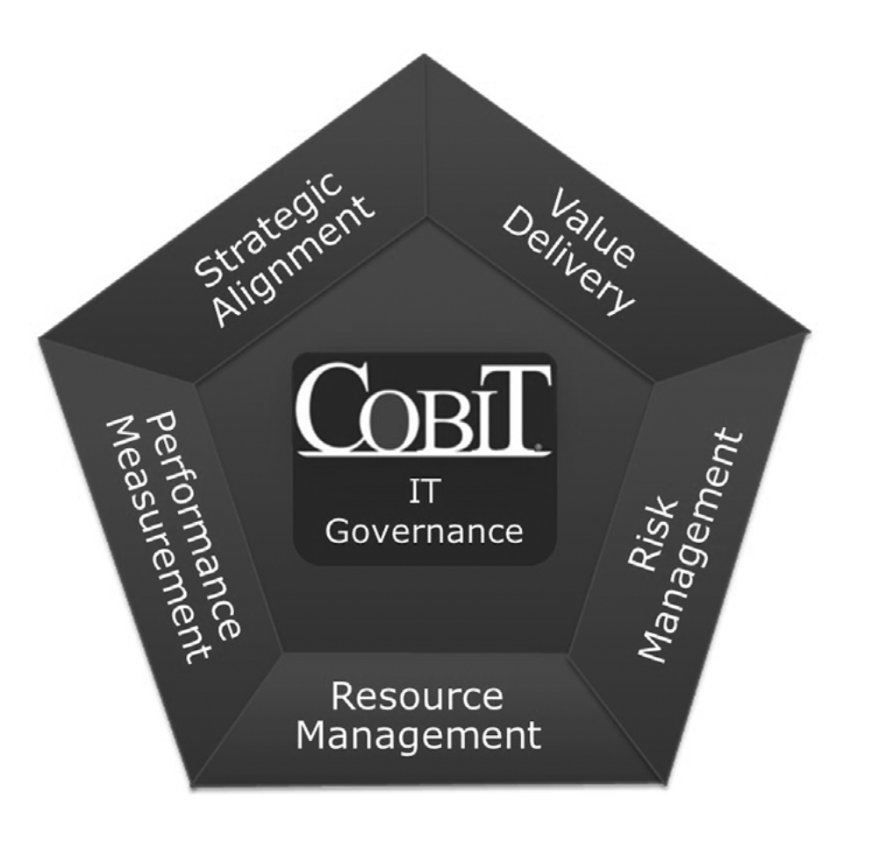
COBIT
We illustrate the COBIT framework's focus on five key areas essential for IT governance: Strategic Alignment, Value Delivery, Risk Management, Resource Management, and Performance Measurement. These areas collectively ensure that IT supports and aligns with business goals while managing risks and resources effectively.

Slide 34
COBIT
Consider a company in Melbourne, Australia, named "TechWave Solutions." They use the COBIT framework to:
Strategic Alignment: Align IT initiatives with business strategies.
Value Delivery: Ensure that IT investments provide optimal value.
Risk Management: Identify and mitigate IT-related risks.
Resource Management: Efficiently allocate and manage IT resources.
Performance Measurement: Monitor and assess IT performance against goals.
By focusing on these areas, TechWave Solutions can enhance its IT governance and ensure that its IT capabilities contribute positively to its overall business objectives.

Slide 35
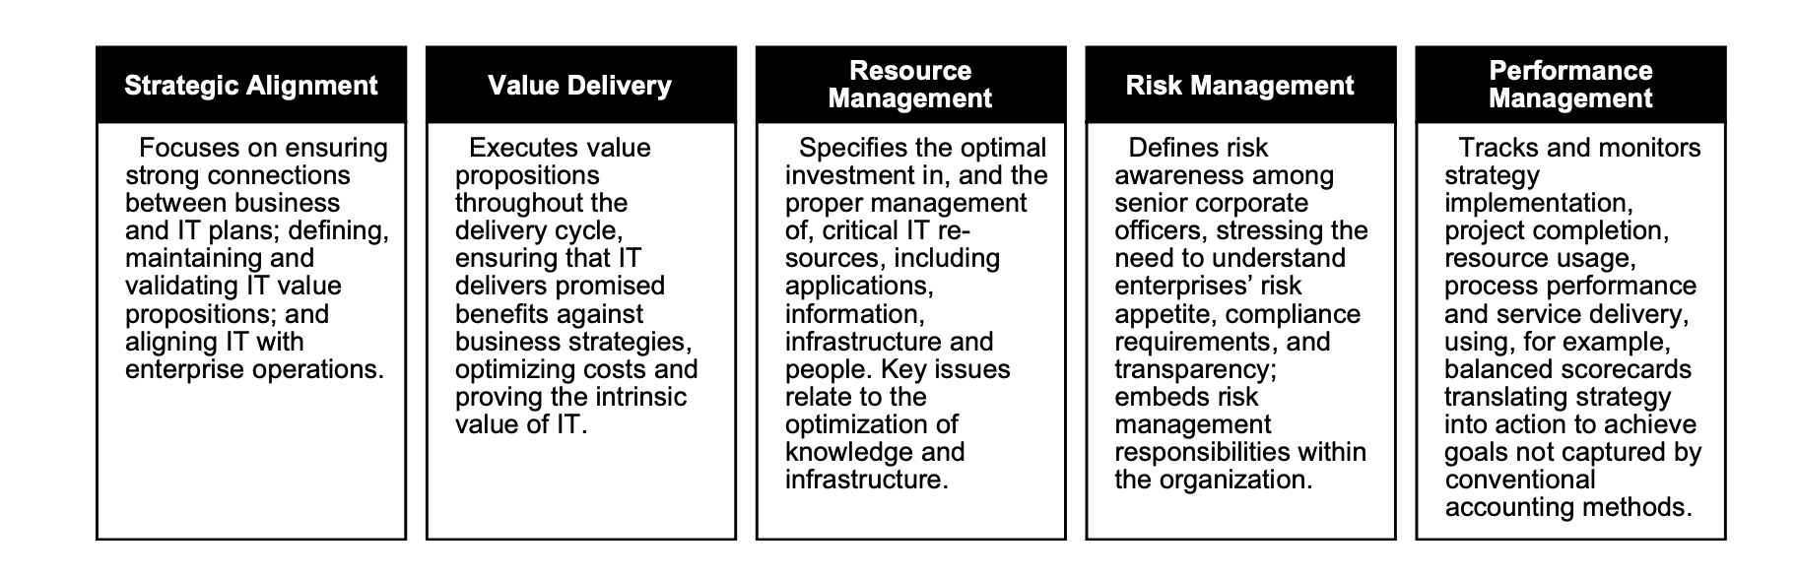
IT Governance Focus Areas in COBIT
We detail the five focus areas in COBIT for IT Governance: Strategic Alignment, Value Delivery, Resource Management, Risk Management, and Performance Management. Each area outlines specific goals, such as aligning IT with business strategies, ensuring IT delivers value, managing resources efficiently, embedding risk management within the organization, and monitoring performance.

Slide 36
IT Governance Focus Areas in COBIT
Consider a company in Sydney, Australia, named "NextGen Enterprises." They utilize the COBIT framework to:
Strategic Alignment: Ensure their IT projects support their business objectives and operations.
Value Delivery: Optimize costs and deliver IT solutions that meet business needs.
Resource Management: Allocate IT resources effectively, ensuring optimal use of applications and infrastructure.
Risk Management: Identify and manage IT-related risks, ensuring compliance and transparency.
Performance Management: Use balanced scorecards to monitor IT performance and ensure strategic goals are met.
By focusing on these areas, NextGen Enterprises can enhance their IT governance and ensure their IT investments contribute positively to their overall business success.

Slide 37
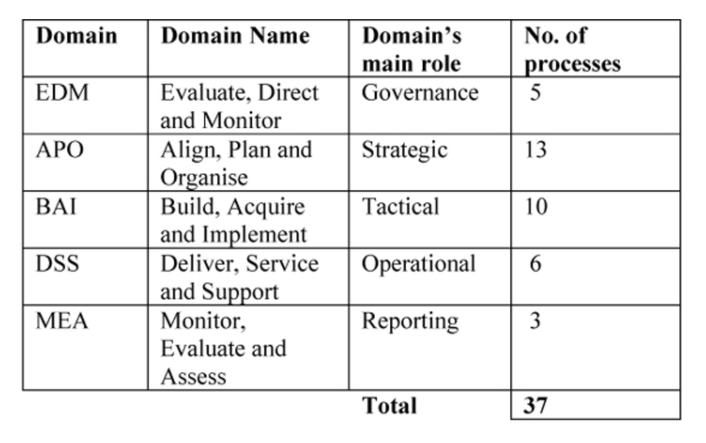
Cobit 5
COBIT 5 has 37 processes in five domains.
Evaluate, Direct and Monitor (EDM)
Align, Plan and Organise (APO)
Build, Acquire and Implement (BAI)
Deliver, Service and Support (DSS)
Monitor, Evaluate and Assess (MEA)
We provide an overview of COBIT 5, highlighting its 37 processes across five domains: Evaluate, Direct and Monitor (EDM), Align, Plan and Organize (APO), Build, Acquire and Implement (BAI), Deliver, Service and Support (DSS), and Monitor, Evaluate and Assess (MEA). Each domain serves a specific role in IT governance, from governance and strategic planning to tactical implementation, operational support, and reporting.

Slide 38
Cobit 5
COBIT 5 has 37 processes in five domains.
Evaluate, Direct and Monitor (EDM)
Align, Plan and Organise (APO)
Build, Acquire and Implement (BAI)
Deliver, Service and Support (DSS)
Monitor, Evaluate and Assess (MEA)
Consider a company in Canberra, Australia, named "CapitalTech Services." They implement COBIT 5 to structure their IT governance:
EDM: Establish governance practices to evaluate and direct IT performance.
APO: Develop strategic IT plans aligned with business goals.
BAI: Manage IT project implementations and acquisitions.
DSS: Provide operational support and IT service delivery.
MEA: Continuously monitor and assess IT processes to ensure compliance and performance.
By adopting COBIT 5, CapitalTech Services can effectively manage and govern their IT operations, ensuring alignment with their organizational objectives.

Slide 39
We explain ITIL (Information Technology Infrastructure Library), which is a framework of best practices aimed at improving the delivery of high-quality IT services cost-effectively. It emphasizes that ITIL's guidelines are adaptable to any tools, vendors, or industries and should be customized by organizations to fit their specific business needs.
Library (ITIL)
ITIL is a framework of best practices, based on a process-based approach, to improve the delivery of high-quality IT services at a low cost.
The content of ITIL is independent of tools, vendors, or industry in which the service is executed and can be applied to organizations of any size.
However, it is not intended to be applied as-is; organizations are motivated to adapt it to meet their own business needs.

Slide 40
Consider a company in Brisbane, Australia, named "Brisbane IT Services." They implement ITIL to enhance their IT service delivery by:
Framework of Best Practices: Using ITIL's process-based approach to streamline their IT operations and reduce costs.
Adaptable Content: Customizing ITIL guidelines to fit their unique business requirements and existing IT infrastructure.
By doing so, Brisbane IT Services can improve service quality and efficiency, ensuring they meet their clients' needs effectively.
Library (ITIL)
ITIL is a framework of best practices, based on a process-based approach, to improve the delivery of high-quality IT services at a low cost.
The content of ITIL is independent of tools, vendors, or industry in which the service is executed and can be applied to organizations of any size.
However, it is not intended to be applied as-is; organizations are motivated to adapt it to meet their own business needs.

Slide 41
Structure of ITIL v4
Key concepts (key concepts) of service management
Service management
Organizations and individuals
Information technology
Partners and suppliers
Value flows and processes.
Service Value System (SVS)
Management Practices.
We outline the structure of ITIL v4, which includes key concepts of service management, service management elements (organizations and individuals, information technology, partners and suppliers, value flows and processes), the Service Value System (SVS), and management practices. These components collectively provide a framework for effective IT service management.

Slide 42
Structure of ITIL v4
Consider a company in Melbourne, Australia, named "Melbourne IT Solutions." They use ITIL v4 to structure their IT service management by:
Key Concepts: Understanding and applying fundamental principles of service management.
Service Management: Managing relationships with partners and suppliers, optimizing value flows, and aligning IT with business processes.
Service Value System (SVS): Implementing a holistic approach to create value through IT services.
Management Practices: Adopting best practices to ensure efficient and effective IT operations.
By integrating these elements, Melbourne IT Solutions can improve their service delivery and ensure alignment with business goals.
Key concepts (key concepts) of service management
Service management
Organizations and individuals
Information technology
Partners and suppliers
Value flows and processes.
Service Value System (SVS)
Management Practices.

Slide 43
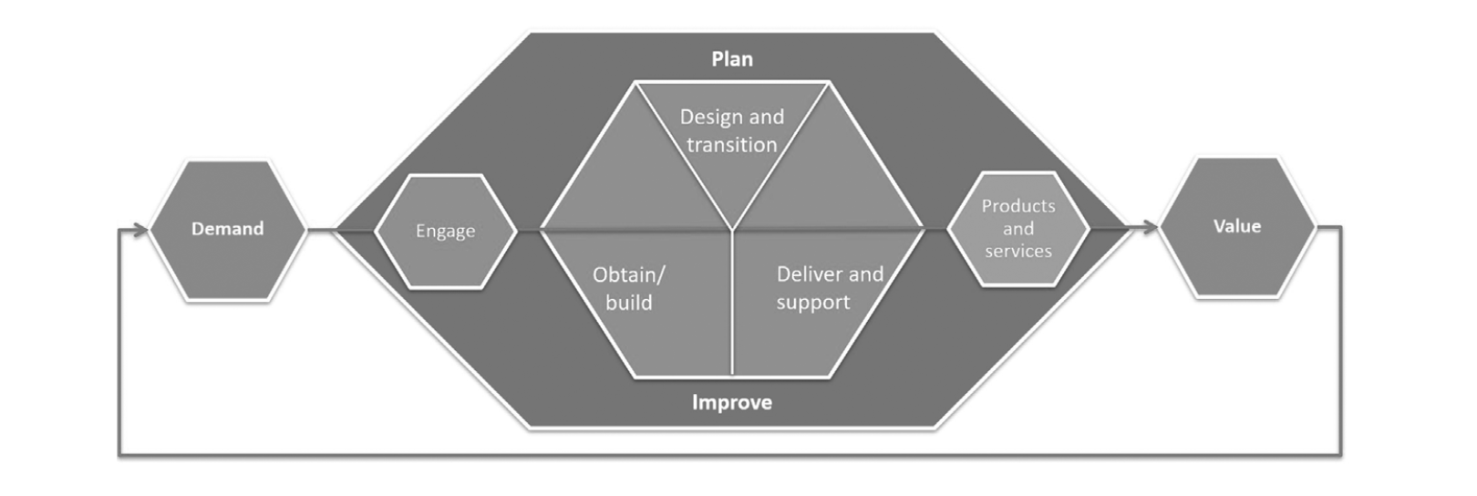
ITIL Service Value Chain
We illustrate the ITIL Service Value Chain, which is a model representing how demand for services leads to value through a series of interconnected activities: Plan, Engage, Design and Transition, Obtain/Build, Deliver and Support, and Improve. These activities work together to ensure effective service management and delivery

Slide 44
ITIL Service Value Chain
Consider a company in Sydney, Australia, named "SydneyTech Services." They apply the ITIL Service Value Chain to manage their IT services:
Plan: Strategizing and planning IT service activities.
Engage: Interacting with stakeholders to understand their needs.
Design and Transition: Designing and transitioning new or changed services.
Obtain/Build: Acquiring or building necessary service components.
Deliver and Support: Delivering services and providing support to users.
Improve: Continuously improving services based on feedback and performance data.
By following this value chain, SydneyTech Services ensures that they efficiently meet customer demands and deliver high-value IT services.

Slide 45
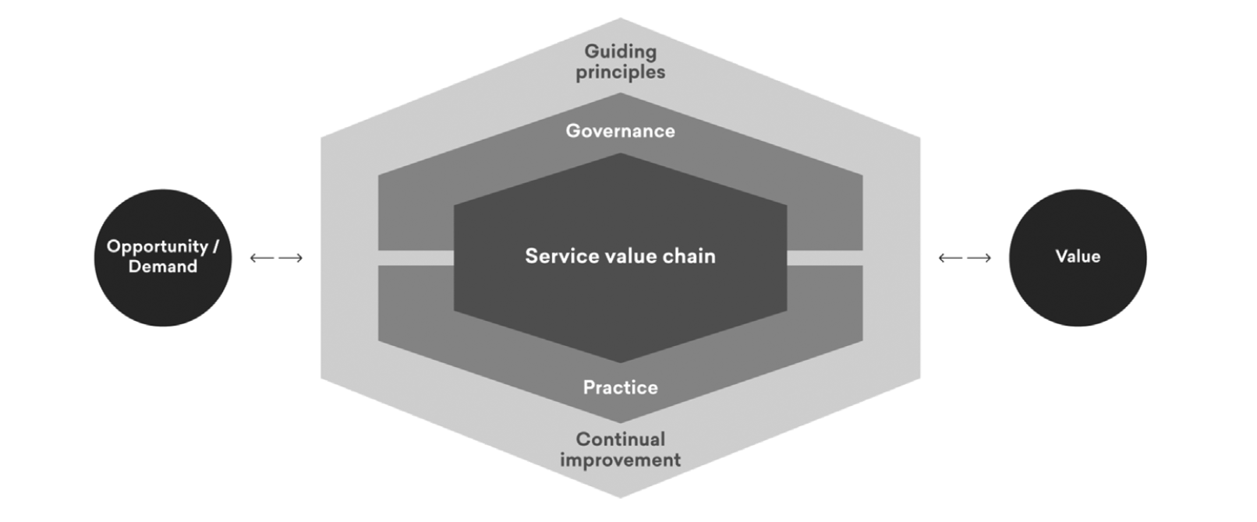
ITIL Service Value System
We depict the ITIL Service Value System (SVS), which integrates various components such as guiding principles, governance, service value chain, practices, and continual improvement to convert opportunities and demands into value. The SVS ensures a holistic approach to managing IT services effectively.

Slide 46
ITIL Service Value System
Consider a company in Canberra, Australia, named "Canberra IT Solutions." They use the ITIL Service Value System to:
Guiding Principles: Establish foundational principles to guide IT service management.
Governance: Ensure IT governance aligns with corporate strategies.
Service Value Chain: Manage and optimize activities that create value from demand.
Practices: Implement best practices across IT operations.
Continual Improvement: Continuously enhance IT services based on performance data and feedback.
By applying the ITIL SVS, Canberra IT Solutions can effectively turn client demands into valuable IT services, ensuring ongoing improvement and alignment with business goals.

Slide 47
CMMI
We describe CMMI (Capability Maturity Model Integration), a model used to assess the maturity level of an organization's systems, product, and software development processes. It helps control engineering processes to ensure high-quality products and services and serves as a reference for best practices in software development.
The CMMI (Capability Maturity Model Integrated) is a model for assessing the level of maturity of an organization’s systems, product, and/or software development.
It controls engineering processes, and consequently, the quality of the products and services resulting from these processes.
CMMI provides a reference for best practices in software development.

Slide 48
Consider a company in Sydney, Australia, named "Innovative Software Solutions." They implement CMMI to:
Assess Maturity: Evaluate the maturity of their software development processes.
Control Processes: Standardize engineering processes to enhance product quality.
Best Practices: Adopt industry best practices to improve software development efficiency and outcomes.
By using CMMI, Innovative Software Solutions can improve their process maturity, leading to better quality software and more efficient development practices.
CMMI
The CMMI (Capability Maturity Model Integrated) is a model for assessing the level of maturity of an organization’s systems, product, and/or software development.
It controls engineering processes, and consequently, the quality of the products and services resulting from these processes.
CMMI provides a reference for best practices in software development.

Slide 49
We outline the goals of CMMI, which include improving product quality and project productivity, increasing customer satisfaction by better meeting requirements, reducing costs and meeting deadlines, and providing better visibility to management for improved risk management.
Goals of CMMI
Improve the quality of the delivered product and the productivity of the project
Increase customer satisfaction by better meeting their requirements
Reduce costs and meet deadlines
Give better visibility to management and allow better risk management.

Slide 50
Consider a company in Brisbane, Australia, named "Brisbane Software Development." They adopt CMMI to:
Improve Quality and Productivity: Enhance the quality of their software products and streamline project workflows.
Increase Customer Satisfaction: Better understand and meet customer requirements, leading to higher satisfaction.
Reduce Costs and Meet Deadlines: Implement efficient processes to lower costs and ensure projects are completed on time.
Better Visibility and Risk Management: Provide management with clear insights into project progress and risks, allowing for proactive management and mitigation.
By focusing on these goals, Brisbane Software Development can deliver higher quality products more efficiently and maintain better control over their projects.
Goals of CMMI
Improve the quality of the delivered product and the productivity of the project
Increase customer satisfaction by better meeting their requirements
Reduce costs and meet deadlines
Give better visibility to management and allow better risk management.

Slide 51
CMMI Levels
We outline the five levels of CMMI (Capability Maturity Model Integration):
Level 1: Initial - Processes are unpredictable and reactive.
Level 2: Managed - Processes are planned and executed in accordance with policy.
Level 3: Defined - Processes are well-characterized and understood.
Level 4: Quantitatively Managed - Processes are measured and controlled.
Level 5: Optimizing - Focus on process improvement.
Level 1: Initial
Level 2: Managed
Level 3: Defined
Level 4: Quantitatively Managed
Level 5: Optimizing

Slide 52
Consider a company in Sydney, Australia, named "Sydney Tech Innovations." They use CMMI to progress through these levels:
Level 1: Initially, their processes are ad hoc and chaotic.
Level 2: They begin managing projects according to defined policies.
Level 3: Processes become standardized across the organization.
Level 4: They use quantitative metrics to manage processes.
Level 5: They continuously improve processes based on performance data.
By advancing through these levels, Sydney Tech Innovations can systematically enhance their process maturity, leading to more reliable and efficient operations.
CMMI Levels
Level 1: Initial
Level 2: Managed
Level 3: Defined
Level 4: Quantitatively Managed
Level 5: Optimizing

Slide 53
We explain that the Committee of Sponsoring Organizations (COSO) framework helps organizations reduce asset loss risk, ensure the reliability of financial statements, and promote compliance with laws and regulations to improve operational efficiency. The three categories of COSO objectives are the effectiveness and efficiency of operations, reliability of financial reporting, and compliance with applicable laws and regulations.
COSO
The Committee of Sponsoring Organizations (COSO) aims to help organisations reduce the risk of asset loss, ensure the reliability of financial statements and compliance with laws and regulations, and promote efficiency.
Three categories of objectives are
Effectiveness and efficiency of operations
Reliability of financial reporting
Compliance with applicable laws and regulations

Slide 54
Consider a company in Melbourne, Australia, named "Melbourne Financial Services." They implement the COSO framework to:
Effectiveness and Efficiency: Enhance the efficiency of their operations and reduce risks of asset loss.
Reliability of Financial Reporting: Ensure their financial statements are accurate and reliable.
Compliance: Adhere to relevant laws and regulations to avoid legal issues and promote ethical practices.
By adopting COSO, Melbourne Financial Services can strengthen their internal controls and improve overall organizational governance.
COSO
The Committee of Sponsoring Organizations (COSO) aims to help organisations reduce the risk of asset loss, ensure the reliability of financial statements and compliance with laws and regulations, and promote efficiency.
Three categories of objectives are
Effectiveness and efficiency of operations
Reliability of financial reporting
Compliance with applicable laws and regulations

Slide 55
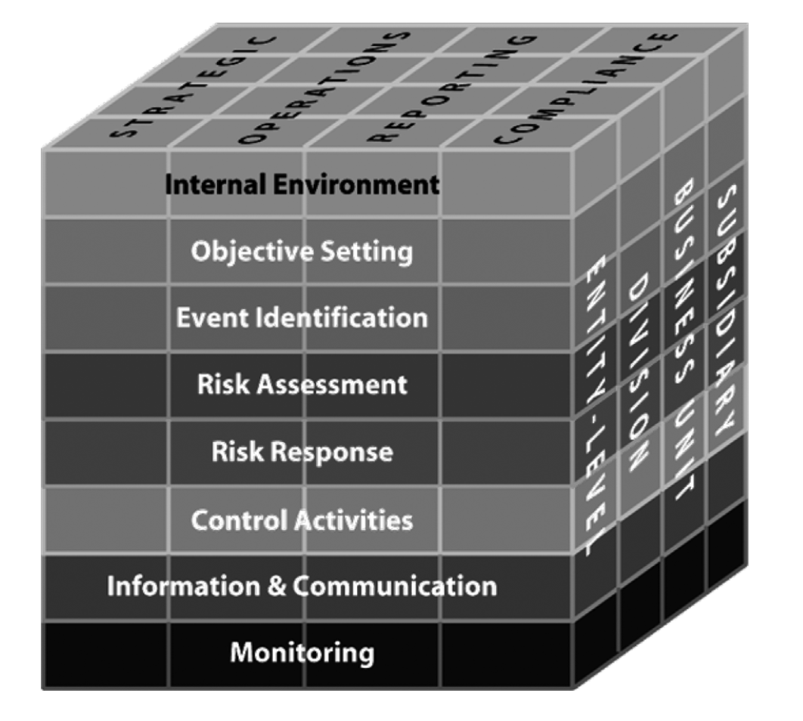
ERM Model by CSO (1)
Internal environment: The internal environment describes the work environment and risk preferences of an organization and sets the framework for how risk is viewed and addressed by its management and employees.
Objective setting: Objectives must be set up-front.
Event identification: Internal and external events affecting the achievement of an entity’s objectives must be identified, distinguishing between risks and opportunities.
We explain the ERM (Enterprise Risk Management) Model by COSO, highlighting the internal environment, objective setting, and event identification as key components. The internal environment defines the organizational culture and risk preferences, objective setting ensures goals are established upfront, and event identification involves recognizing internal and external events that may impact achieving these objectives, distinguishing between risks and opportunities.

Slide 56
ERM Model by CSO (1)
Internal environment: The internal environment describes the work environment and risk preferences of an organization and sets the framework for how risk is viewed and addressed by its management and employees.
Objective setting: Objectives must be set up-front.
Event identification: Internal and external events affecting the achievement of an entity’s objectives must be identified, distinguishing between risks and opportunities.
Consider a company in Sydney, Australia, named "Sydney Enterprises." They use the COSO ERM model to:
Internal Environment: Foster a risk-aware culture and define risk preferences.
Objective Setting: Set clear goals for their strategic, operational, reporting, and compliance objectives.
Event Identification: Identify potential risks and opportunities that could affect their objectives, enabling proactive management.
By implementing these components, Sydney Enterprises can create a structured approach to risk management, enhancing their ability to achieve business goals while mitigating potential risks.

Slide 57
ERM Model by CSO (2)
Risk assessment: Risks are analyzed, considering the likelihood of occurrence and impact, as a basis for determining how they should be managed.
Risk response: Management selects risk responses – avoiding, accepting, reducing, or sharing risk – developing a set of actions to align risks with the entity’s risk tolerances and risk appetite.
Control activities: Policies and procedures should be established and implemented to help ensure the risk responses are effectively carried out.
We continue explaining the ERM (Enterprise Risk Management) Model by COSO, focusing on risk assessment, risk response, and control activities. Risk assessment involves analyzing risks based on their likelihood and impact to determine management strategies. Risk response entails choosing appropriate actions—such as avoiding, accepting, reducing, or sharing risks—to align with the entity's risk tolerance and appetite. Control activities refer to establishing policies and procedures to ensure effective implementation of risk responses.

Slide 58
Information and communication: Relevant information is identified, captured, and communicated in a form and timeframe that enable people to carry out their responsibilities. Effective communication also occurs in a broader sense – flowing down, across, and up the entity
Monitoring: The entirety of enterprise risk management must be monitored, and modifications made as necessary.
ERM Model by CSO (3)
We continue explaining the ERM (Enterprise Risk Management) Model by COSO, focusing on information and communication, and monitoring. Information and communication involve identifying, capturing, and communicating relevant information effectively across the organization. Monitoring ensures that the entire risk management process is continuously observed and adjusted as necessary.

Slide 59
ERM Model by CSO (3)
Information and communication: Relevant information is identified, captured, and communicated in a form and timeframe that enable people to carry out their responsibilities. Effective communication also occurs in a broader sense – flowing down, across, and up the entity
Monitoring: The entirety of enterprise risk management must be monitored, and modifications made as necessary.
Consider a company in Sydney, Australia, named "Sydney Financial Group." They use the COSO ERM model by:
Information and Communication: Implementing systems to ensure that risk-related information is effectively communicated across all levels of the organization.
Monitoring: Regularly reviewing and assessing the risk management processes to identify any necessary adjustments or improvements.
By integrating these components, Sydney Financial Group can maintain a robust and responsive risk management framework that supports their organizational goals and compliance requirements.

Slide 60
ISO/IEC 27001:2005
We discuss ISO/IEC 27001:2005, a standard for information security management, which was revised by ISO/IEC 27001:2013. ISO 27001 defines requirements and control points to protect IT assets from loss, theft, intrusion, or alteration. ISO 207002 provides guidelines for implementing or maintaining an Information Security Management System (ISMS), ensuring the protection of information infrastructure.
ISO 27000 is a suite of good practices grouped into standards that deal with information security.
Revised by ISO/IEC 27001:2013
The only standard leading to certification is ISO 27001, which defines a set of requirements and control points to protect IT assets against any loss, theft, intrusion, or alteration of the IT system.
ISO 207002 is a good practice guide listing measures for implementing or maintaining an Information Security Management System (ISMS) (ISO, 2013).
Good practices are applied to IS security rules to guarantee the protection of its infrastructure.

Slide 61
Consider a company in Canberra, Australia, named "Capital IT Solutions." They implement ISO 27001 to:
Protect IT Assets: Establish a robust ISMS to safeguard their data and IT infrastructure against threats.
Achieve Certification: Follow ISO 27001 requirements to achieve certification, demonstrating their commitment to information security.
Maintain Good Practices: Use ISO 207002 guidelines to continuously improve their ISMS and ensure compliance with the latest security standards.
By adopting these standards, Capital IT Solutions can enhance their information security, build trust with clients, and reduce the risk of data breaches.
ISO/IEC 27001:2005
ISO 27000 is a suite of good practices grouped into standards that deal with information security.
Revised by ISO/IEC 27001:2013
The only standard leading to certification is ISO 27001, which defines a set of requirements and control points to protect IT assets against any loss, theft, intrusion, or alteration of the IT system.
ISO 207002 is a good practice guide listing measures for implementing or maintaining an Information Security Management System (ISMS) (ISO, 2013).
Good practices are applied to IS security rules to guarantee the protection of its infrastructure.

Slide 62
Practical Use of Standards
Use within organisations to formulate security requirements and objectives
Use within organisations as a way to ensure that security risks are cost-effectively managed
Use within organisations to ensure compliance with laws and regulations
Use within an organisation as a process framework for the implementation and management of controls to ensure that the specific security objectives of an organisation are met
Definition of new information security management processes
Identification and clarification of existing information security management processes
Use by the management of organisations to determine the status of information security management activities
Use by the internal and external auditors of organisations to determine the degree of compliance with the policies, directives, and standards adopted by an organization
Use by organisations to provide relevant information about information security policies, directives, standards, and procedures to trading partners and other organisations with whom they interact for operational or commercial reasons
Implementation of business-enabling information security
Use by organisations to provide relevant information about information security to customers.
We detail various practical uses of information security standards within organizations. These uses include formulating security requirements, managing security risks cost-effectively, ensuring compliance with laws, providing frameworks for implementing controls, defining and clarifying security processes, and communicating security policies to stakeholders.

Slide 63
Practical Use of Standards
Consider a company in Sydney, Australia, named "Sydney Tech Solutions." They use information security standards to:
Formulate Security Requirements: Define their security objectives and policies.
Manage Security Risks: Implement cost-effective measures to mitigate security risks.
Ensure Compliance: Adhere to relevant laws and regulations through standardized practices.
Implement Controls: Use a process framework to manage and implement security controls.
Communicate Policies: Provide relevant information about their security policies to customers and trading partners.
By using these standards, Sydney Tech Solutions can enhance their security posture, ensure regulatory compliance, and build trust with their stakeholders.
Use within organisations to formulate security requirements and objectives
Use within organisations as a way to ensure that security risks are cost-effectively managed
Use within organisations to ensure compliance with laws and regulations
Use within an organisation as a process framework for the implementation and management of controls to ensure that the specific security objectives of an organisation are met
Definition of new information security management processes
Identification and clarification of existing information security management processes
Use by the management of organisations to determine the status of information security management activities
Use by the internal and external auditors of organisations to determine the degree of compliance with the policies, directives, and standards adopted by an organization
Use by organisations to provide relevant information about information security policies, directives, standards, and procedures to trading partners and other organisations with whom they interact for operational or commercial reasons
Implementation of business-enabling information security
Use by organisations to provide relevant information about information security to customers.

Slide 64
NIST
We describe the NIST (National Institute of Standards and Technology) Cybersecurity Framework (CSF), which is designed to improve the cybersecurity of critical infrastructure. The framework provides organizations with a structure to assess and enhance their ability to prevent, detect, and respond to cyber incidents, integrating cybersecurity into the overall risk management processes.
The National Institute of Standards and Technology (NIST) Framework for Improving Critical Infrastructure Cybersecurity
NIST Cybersecurity Framework (CSF) provides private sector organisations with a structure to assess and improve their ability to prevent, detect, and respond to cyber incidents.
The Framework uses operational factors to guide cybersecurity activities and considers cybersecurity as part of an organization’s risk management processes.
Many organisations are adopting this framework to help manage their cybersecurity risks.

Slide 65
NIST
Consider a company in Brisbane, Australia, named "Brisbane Critical Infrastructure Solutions." They adopt the NIST Cybersecurity Framework to:
Assess and Improve Cybersecurity: Evaluate their current cybersecurity posture and implement measures to enhance their defenses against cyber threats.
Operational Guidance: Use the framework to guide their cybersecurity activities and integrate these efforts into their broader risk management strategy.
Incident Response: Develop robust processes to prevent, detect, and respond to cyber incidents effectively.
By implementing the NIST CSF, Brisbane Critical Infrastructure Solutions can better manage their cybersecurity risks and protect their critical assets.
The National Institute of Standards and Technology (NIST) Framework for Improving Critical Infrastructure Cybersecurity
NIST Cybersecurity Framework (CSF) provides private sector organisations with a structure to assess and improve their ability to prevent, detect, and respond to cyber incidents.
The Framework uses operational factors to guide cybersecurity activities and considers cybersecurity as part of an organization’s risk management processes.
Many organisations are adopting this framework to help manage their cybersecurity risks.

Slide 66
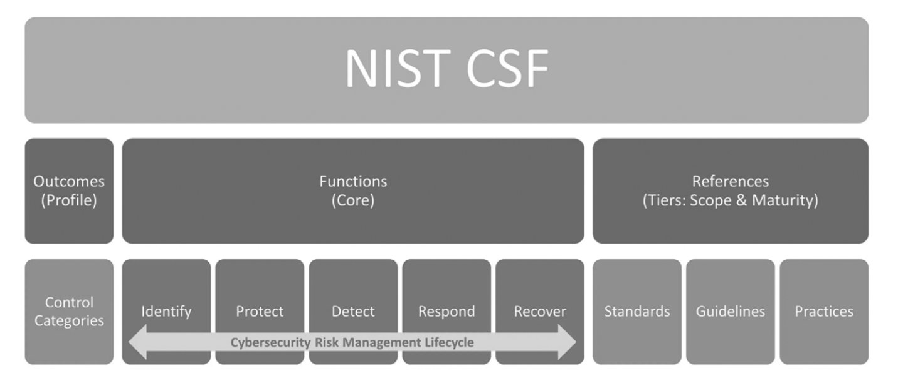
Three Components of NIST-CSF
We outline the three components of the NIST Cybersecurity Framework (CSF): Outcomes (Profile), Functions (Core), and References (Tiers: Scope & Maturity). The core functions of the framework include Identify, Protect, Detect, Respond, and Recover, which form the basis of the cybersecurity risk management lifecycle. These components help organizations assess and improve their cybersecurity posture.

Slide 67
Three Components of NIST-CSF
Consider a company in Melbourne, Australia, named "Melbourne CyberSecure." They use the NIST CSF to:
Outcomes (Profile): Define their cybersecurity goals and desired outcomes.
Functions (Core): Implement the core functions—Identify, Protect, Detect, Respond, and Recover—to manage cybersecurity risks.
References (Tiers: Scope & Maturity): Assess their current cybersecurity maturity and scope to prioritize improvements.
By using these components, Melbourne CyberSecure can systematically enhance their cybersecurity measures, ensuring a comprehensive approach to risk management.

Slide 68

Literature
Belaissaoui, M., Sahid, A., Maleh, Y., Alazab, M. (2021). IT Governance and Information Security: Guides, Standards and Frameworks. (n.p.): CRC Press.

Slide 69
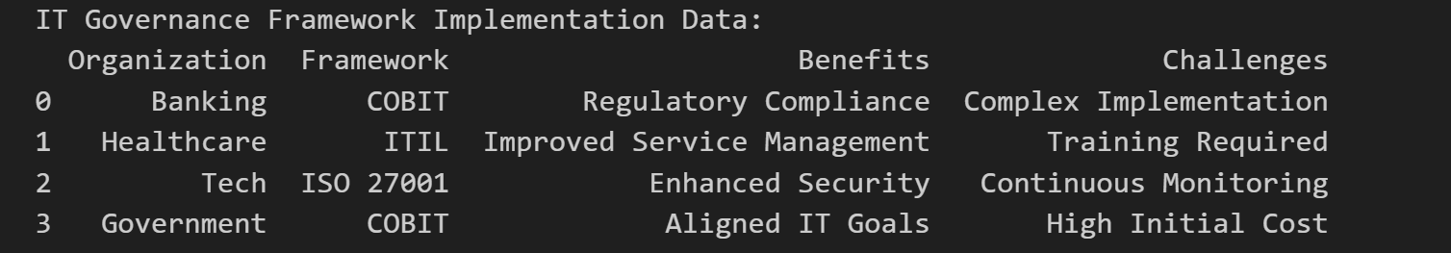
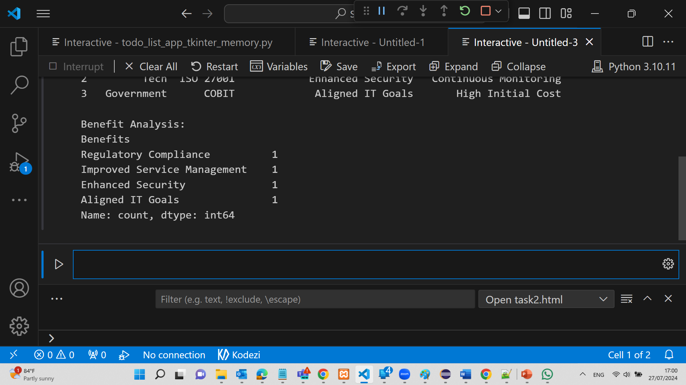
IT Governance Framework Implementation Data:
The table presents data on the implementation of IT governance frameworks across various organizations, detailing the benefits and challenges each organization faces.
Organization: This column lists the type of organization.
Framework: This column shows the specific IT governance framework implemented by each organization.
Benefits: This column highlights the primary benefit achieved from implementing the framework.
Challenges: This column identifies the main challenge faced during the implementation.

Slide 70
IT Governance Framework Implementation Data:
Data Breakdown:
Banking Sector
Framework: COBIT
Benefits: Regulatory Compliance
Challenges: Complex Implementation
Healthcare Sector
Framework: ITIL
Benefits: Improved Service Management
Challenges: Training Required

Slide 71
IT Governance Framework Implementation Data:
Tech Sector
Framework: ISO 27001
Benefits: Enhanced Security
Challenges: Continuous Monitoring
Government Sector
Framework: COBIT
Benefits: Aligned IT Goals
Challenges: High Initial Cost

Slide 72
IT Governance Framework Implementation Data:
Benefit Analysis:
This part of the table summarizes the frequency of each benefit derived from the implementation of the frameworks.
Regulatory Compliance: Mentioned 1 time
Improved Service Management: Mentioned 1 time
Enhanced Security: Mentioned 1 time
Aligned IT Goals: Mentioned 1 time

Slide 73
IT Governance Framework Implementation Data:
1. Regulatory Compliance (Banking Sector)
Implementing COBIT in the banking sector helps meet regulatory requirements but faces challenges due to the complexity of implementation.
2. Improved Service Management (Healthcare Sector)
ITIL framework improves service management in healthcare by standardizing processes but requires significant training for staff.

Slide 74
IT Governance Framework Implementation Data:
3. Enhanced Security (Tech Sector)
ISO 27001 enhances security measures in tech organizations but demands continuous monitoring to maintain standards.
4. Aligned IT Goals (Government Sector)
COBIT helps government organizations align their IT operations with strategic goals, although it involves high initial implementation costs.

Slide 75
IT Governance Framework Implementation Data:
Conclusion:
Each organization implements a specific IT governance framework to achieve certain benefits, which are counterbalanced by specific challenges. The benefit analysis shows an equal distribution of different benefits across sectors, indicating varied objectives and outcomes depending on the organizational context and the chosen framework.

Slide 76
Interactive Questions
What is the primary goal of IT governance frameworks?
a) Increase IT spending
b) Align IT with business objectives
c) Reduce marketing costs
d) Enhance financial management
Which framework focuses on information security management?
a) COBIT
b) ITIL
c) ISO 27001
d) PRINCE2

Slide 77
Interactive Questions
What method can organizations use to monitor IT governance performance?
a) Customer feedback
b) Financial audits
c) Performance metrics and indicators
d) Marketing surveys

Slide 78
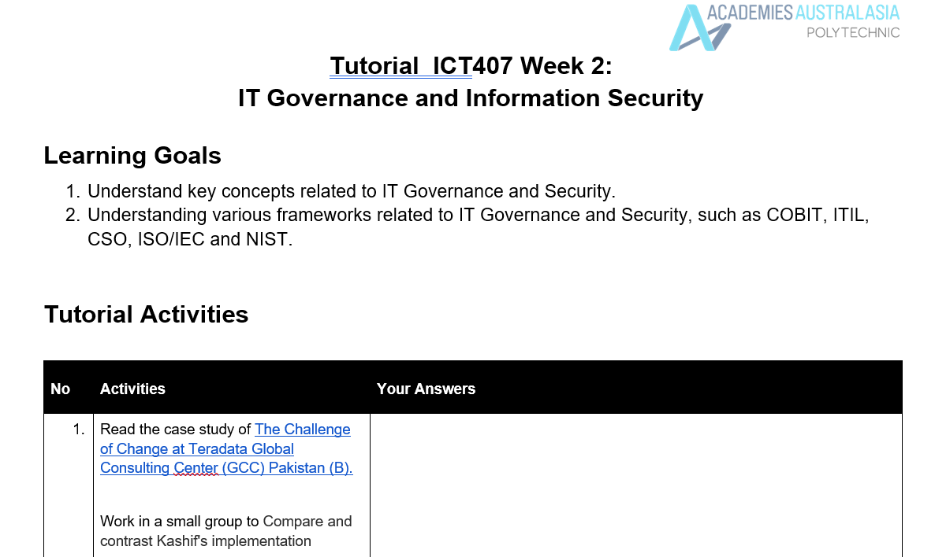
Tutorial Week 2

Slide 79
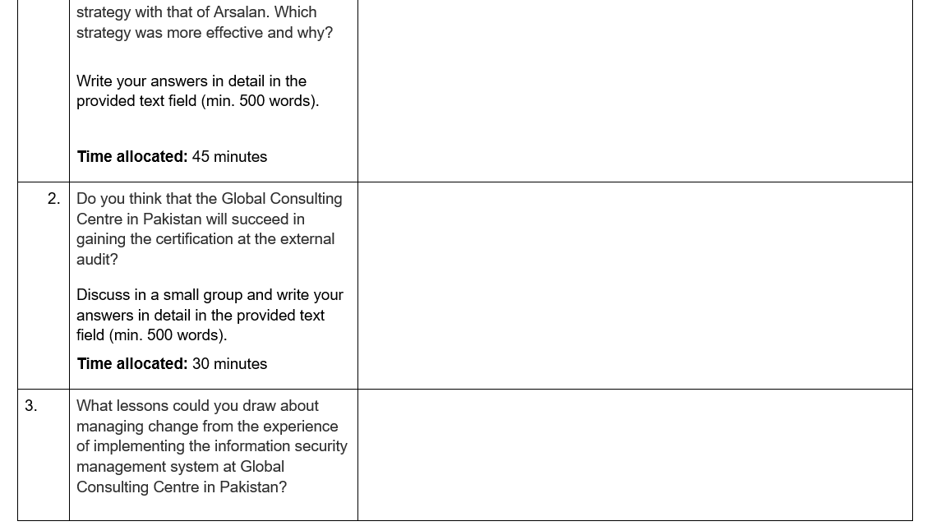
Tutorial Week 2

Slide 80
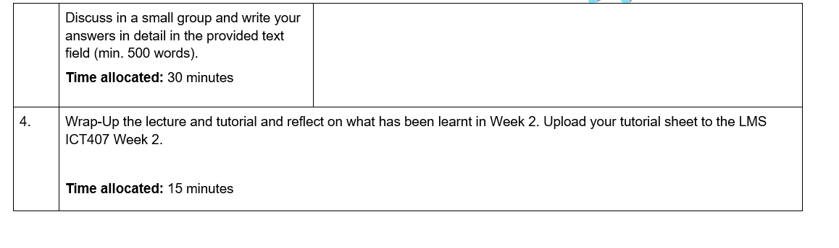
Tutorial Week 2

